Slide 1

Green Pace
Security Policy Presentation
Developer: Aaron McDonald

Slide 2

OVERVIEW: DEFENSE IN DEPTH
Defense in depth starts from the beginning and should never be left to the end of development.

Slide 3
THREATS MATRIX
Likely Data Types Data Values Strings SQL Injection Memory Protection Exceptions Array Indexing | Priority Data Types Strings SQL Injection Array Indexing
Low priority Data Values Memory Protection Assertions Exceptions Order of Operations Single Purpose Functions | Unlikely Assertions Order of Operations Single Purpose Functions

Slide 4
10 PRINCIPLES
Validate Input Data
Standards: Strings, SQL Injection, Assertions
Heed Compiler Warnings
Standards: Order of Operations
Architect and Design for Security Policies
Keep it Simple
Standards: Memory Protection, Single Purpose Functions
Default Deny
Adhere to the Principle of Least Privilege
Sanitize Data Sent to Other Systems
Practice Defense in Depth
Standards: Strings
Use Effective Quality Assurance Techniques
Standards: Data Types, Assertions, Exceptions, Order of Operations, Array Indexing
Adopt a Secure Coding Standard
Standards: Data Value, Strings, Memory Protection, Exceptions

Slide 5
CODING STANDARDS
String Correctness
Array Indexing
SQL Injection
Memory Protection
Data Typing
Data Value
Exceptions
Single Purpose Functions
Assertions
Order of Operations

Slide 6
ENCRYPTION POLICIES
Encrypt, encrypt, encrypt… just about summarizes things…
Data at Rest: Should always remain encrypted to avoid prying eyes
Data in Flight: Should be encrypted with a reversable encryption such that when the data is retrieved it can only be decrypted by those meant to receive the data.
Data in Use: Should remain encrypted for as long as possible before being used. There may even be techniques to not need to decrypt the data before use, in which case this should be preferred.
Pretend that everyone wants to see this data, including those that are working with it and those that are within the company.
Use modern cryptographic libraries.

Slide 7
TRIPLE-A POLICIES
Authenticate, Authorize, and Account
Authentication: The process of gaining access
Authorization: What you can do when you have access
Accounting: How what you are doing is being tracked
Adopt a policy of default deny
Adopt a policy of least privilege, allowing only enough authorization to get the job done
Adopt a logging system that can track every user transaction

Slide 8
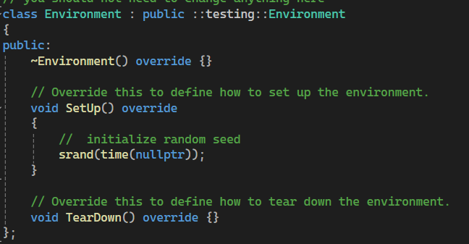
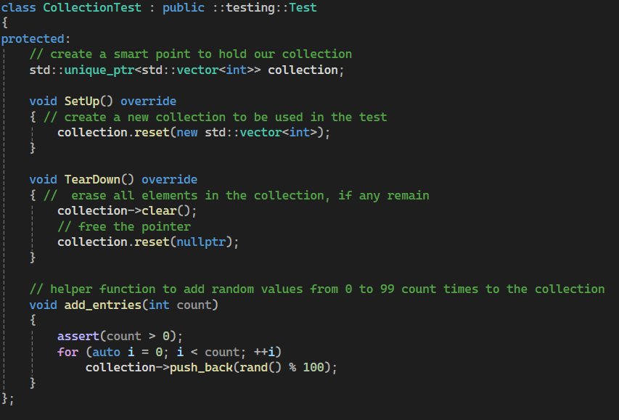
Unit Testing – std::vector - Setup
Using Gtest, starting with creating a setup environment

Slide 9
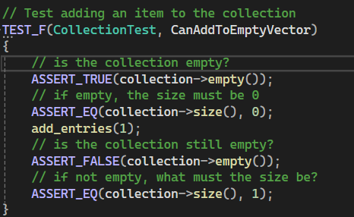
Unit Testing – std::vector - Append
Can we add an item to the collection
Gtest unit test showcase

Slide 10
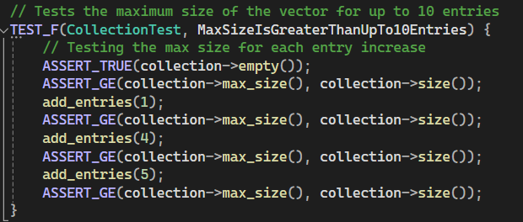
Unit Testing – std::vector - Size
How does the size change for the vector as we add more items

Slide 11
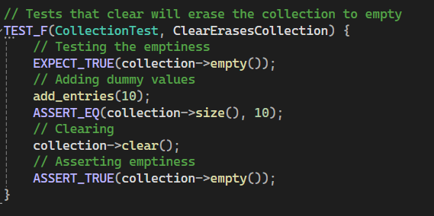
Unit Testing – std::vector – Clearing
How does the size change upon clearing the collection

Slide 12
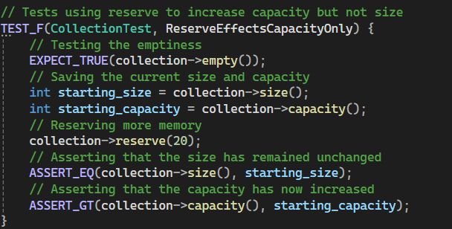
Unit Testing – std::vector – Reserve
How does the reserve function effect memory and size

Slide 13
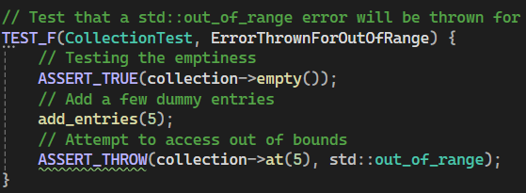
Unit Testing – std::vector – Out of Range
What happens when attempting to access an element out of range

Slide 14
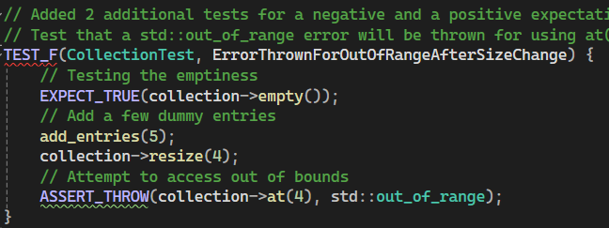
Unit Testing – std::vector – Out of Range Resize
What happens when attempting to access an element that is no long in range

Slide 15

AUTOMATION SUMMARY

Slide 16
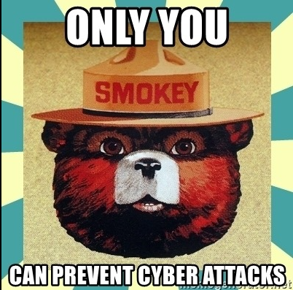
TOOLS
DevSecOps is at every point of the project
Planning, Pre-Production and Production must always have security in mind, planning with security in mind from the beginning
Tools such as CPPCheck, Sonar, Cycode and finally you

Slide 17
RISKS AND BENEFITS
Benefits of acting now
Security is worked in from the beginning
Lower potential costs due to less security breaches
The system is designed with Security, therefore not requiring a re-design when a vulnerability is found
Risks of acting now
You may not be target frequently and may not need a lot of upfront security
It will cost more money and time to develop a secure system from the beginning
Benefits of acting later
Your system will be made and in production much faster
Costs less money upfront
Risks of acting later
Overall greater risk of cost, costing customer trust when a security breach occurs and the cost of damages / losses from the breach
Eventually there will be a breach, acting later makes it more difficult and takes more time to incorporate new security features
Loss of customer trust, causing unrepairable damage to our customer base

Slide 18
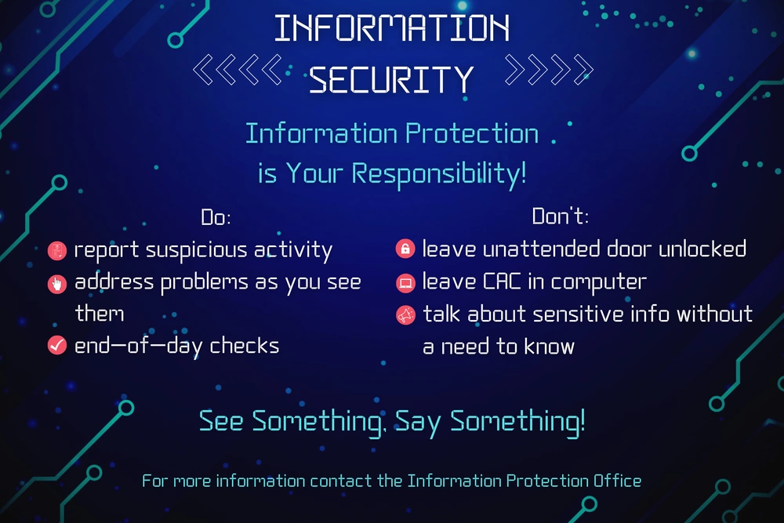
RECOMMENDATIONS
Act now to develop a security plan and avoid unneeded loss of customer data and customer trust
Yahoo had roughly 3 Billion accounts effected by security breaches. This included leaks of names, email address, phone numbers, birth dates, passwords, calendars and security questions

Slide 19
CONCLUSIONS
In general, follow the security policies
Ensure that code is being produced to meet the outlined coding standards
Don’t leave security to the end
Follow best practices for encryption and the Triple-A policies
Utilize automation to assist in creating secure code
Continue to learn and build better and more secure code

Slide 20
REFERENCES
Biggest data breaches in US history (updated 2024): Upguard. RSS. (n.d.). https://www.upguard.com/blog/biggest-data-breaches-us
Seacord, R. C. . (2013). Secure coding in C and C++ Robert C. Seacord. Addison-Wesley.

